Slide 1
Week 1
Introduction to Operational Research
Dr. Sam O’Neill
s.oneill@derby.ac.uk

Slide 2
Module Handbook
Let’s start with a look at the module handbook.
You can find this on the module on Course Resources.

Slide 3
Reading and Software
All you need is given in this course.
We will be working with the Pyomo and SimPy Python Libraries. We will also be using Excel.
You can find OR books in the library if you want to widen your reading.

Slide 4
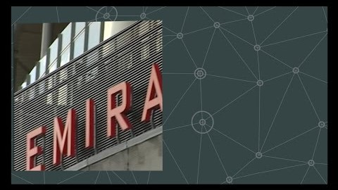
What is Operational Research?
https://www.theorsociety.com/about-or/

Slide 5
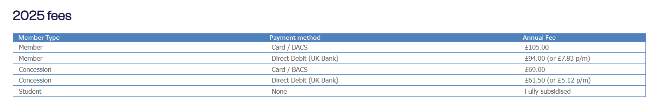
OR Society
https://www.theorsociety.com/

Slide 6

Why?
Most problems don’t have an analytical solution.
Need models and methods that can provide us with a good solution!
Finding a good solution to a problem generally has benefits.
e.g.
  Monetary
  Better decision making
  Time saving
  Space saving
Think Covid Modelling as a famous recent example

Slide 7
Example fields that use Operational Research
Manufacturing
Production
Mechanics
Engineering
Transportation
Scheduling
Networks
Finance

Slide 8
Just Some Practical Applications…
Investment – Portfolio Optimisation
Production – Stock Cutting
Logistics – Distribution, Transportation, Facility Location
Purchasing – Stock control, i.e. reordering
Airlines – Crew scheduling
Sound Engineering – Optimal speaker placement
Health – Optimising drug regimes, e.g. Cancer Chemotherapy
Sport – Diet, training plans, tournament scheduling
Online retail/advertising – Think eBay, Amazon etc…
To name but a few…

Slide 9

OR in real world situations
OR in real world situations | ORS
Business case studies | ORS

Slide 10
Task – 10 minutes in pairs
Pick a business case - Business case studies | ORS
What is the problem?
Who are the stakeholders?
What are the constraints? (resources, time, budget, etc.)
What are the objectives / performance measures? (e.g. cost, time, quality, customer satisfaction)
What methods were used?
What outcomes were achieved (cost savings, time reductions, service improvement, etc.)?
Feedback what you have found out to the class.

Slide 11
What is this module and what will it do for me?
This is a general introduction to the field
It is not a one size fits all module, it takes years to master.
Even then the best will get it wrong. Think Covid-19.
It will teach you how to think and reason about a problem.
It will give you valuable practical skills when applying for jobs.

Slide 12
Career Opportunities
British Airways (BA) • Home Office • Office for National Statistics (ONS) • IBM • DSTL (Defence and Security Analytics) • RBS • Actica (Management and Technical Consulting) • Amey (Data, analytics and Infrastructure) • BGL (Price Comparison and Insurance Distribution and Outsourcing) • EY (Consulting, Assurance, Tax and Transaction Services) • Jaguar Land Rover • NATS (Air Traffic Control Services) • ROKE (Research, Development and Consultancy in Technology) • TUI
Statistician • Data scientist • Data analyst • Operational researcher • Operational analyst
Starting Out in Operational Research | ORS

Slide 13
Task – 10 minutes in groups of 2/3
What interests you about Data Science, AI and Maths?
What sort of career would you like?
Which industries or problems would you like to work on? (e.g. healthcare, climate change, gaming, finance, transport)
What skills do you think you’ll need to get there? (technical, teamwork, communication, ethics)
What impact would you like your work to have? (helping people, saving time/money, protecting the planet, creating new tech)
What excites you most: solving problems, working with people, or building technology?

Slide 14

History of Operational Research
https://www.youtube.com/watch?v=ILWbaWrjgU4

Slide 15
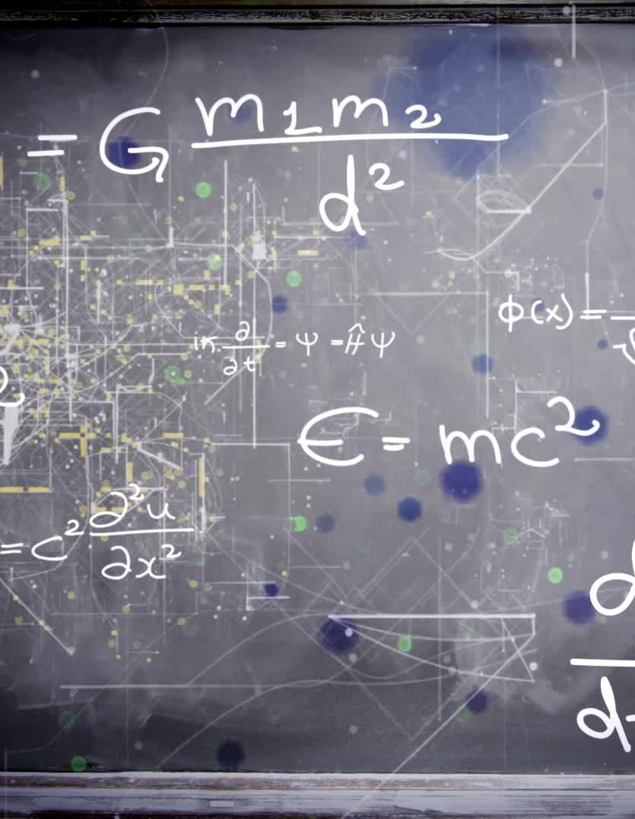
A brief overview of some Maths
You will cover some of this in other modules, but it will help to get a basic idea of the following to start:
Linear Equation
Systems of Equations
Linear Inequalities
N-dimensional Space Intuition
  Hyperplanes
  Half Spaces
  Polytope

Slide 16
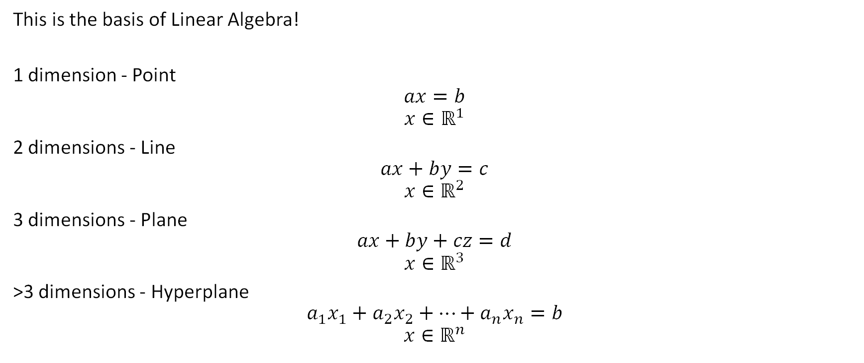
Linear Equation
This is the basis of Linear Algebra!
1 dimension - Point
$$ax=b$$
$$x∈ℝ^{1}$$
2 dimensions - Line
$$ax+by=c$$
$$(x,y)∈ℝ^{2}$$
3 dimensions - Plane
$$ax+by+cz=d$$
$$(x,y,z)∈ℝ^{3}$$
>3 dimensions - Hyperplane
$$a_{1}x_{1}+a_{2}x_{2}+⋯+a_{n}x_{n}=b$$
$$(x_{1},…,x_{n})∈ℝ^{n}$$

Slide 17
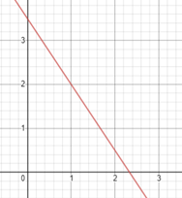
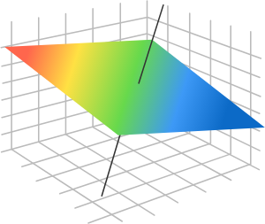

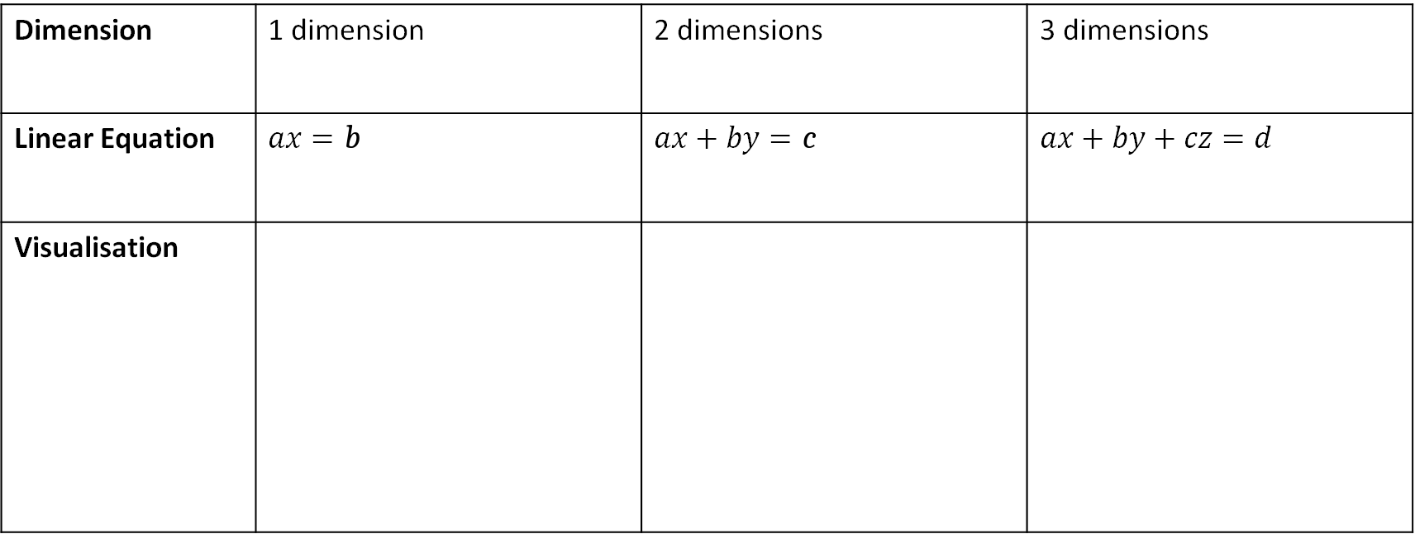
Linear Equation
Dimension | 1 dimension | 2 dimensions | 3 dimensions
Linear Equation | $$ax=b$$ | $$ax+by=c$$ | $$ax+by+cz=d$$
Visualisation

Slide 18
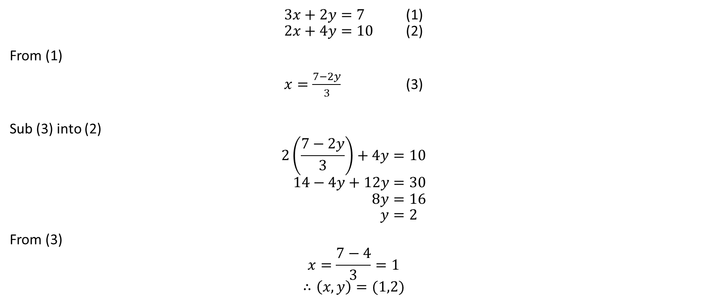
Solving a system of linear equations
$3x+2y=7$ (1)
$2x+4y=10$ (2)
From (1)
$x=\frac{7−2y}{3}$ (3)
Sub (3) into (2)
$$2\left(\frac{7−2y}{3}\right)+4y=10 \\ 14−4y+12y=30 \\ 8y=16 \\ y=2$$
From (3)
$$x=\frac{7−4}{3}=1$$
$$∴\left(x,y\right)=(1,2)$$

Slide 19
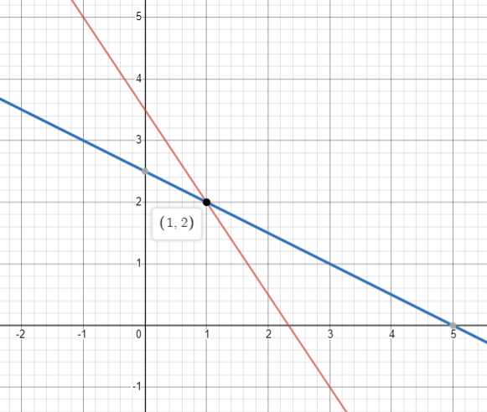


Row picture
$$3x+2y=7$$
$$2x+4y=10$$

Slide 20
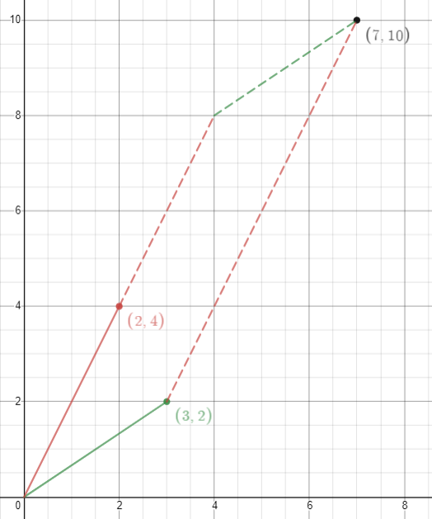
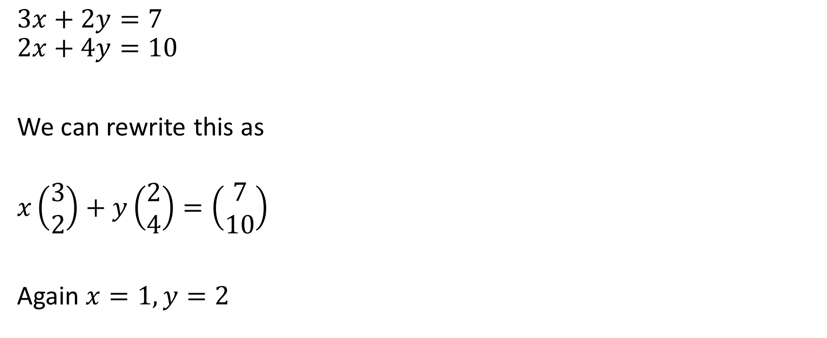


Column picture
$$3x+2y=7 \\ 2x+4y=10$$
We can rewrite this as
$$x\left(\begin{matrix}3 \\ 2\end{matrix}\right)+y\left(\begin{matrix}2 \\ 4\end{matrix}\right)=\left(\begin{matrix}7 \\ 10\end{matrix}\right)$$
Again $x=1, y=2$
$$\left(\begin{matrix}2 \\ 4\end{matrix}\right)$$
$$\left(\begin{matrix}3 \\ 2\end{matrix}\right)$$

Slide 21
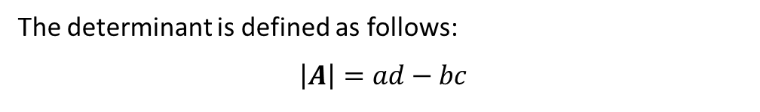
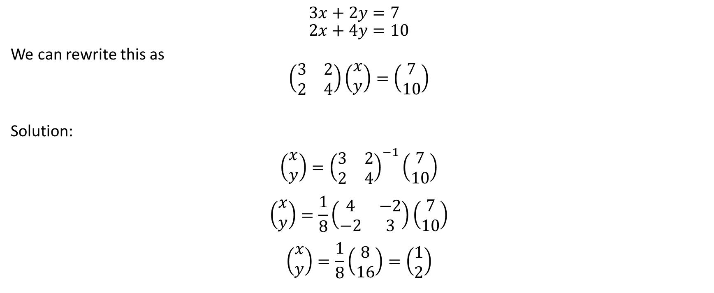
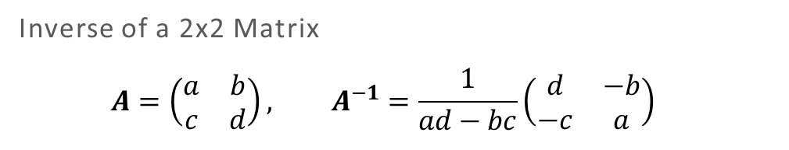
Matrix
Inverse of a 2x2 Matrix
$$A=\left(\begin{matrix}a & b \\ c & d\end{matrix}\right), A^{−1}=\frac{1}{ad−bc}\left(\begin{matrix}d & −b \\ −c & a\end{matrix}\right)$$
The determinant is defined as follows:
$$\left|A\right|=ad−bc$$
$$3x+2y=7 \\ 2x+4y=10$$
We can rewrite this as
$$\left(\begin{matrix}3 & 2 \\ 2 & 4\end{matrix}\right)\left(\begin{matrix}x \\ y\end{matrix}\right)=\left(\begin{matrix}7 \\ 10\end{matrix}\right)$$
Solution:
$$\left(\begin{matrix}x \\ y\end{matrix}\right)={\left(\begin{matrix}3 & 2 \\ 2 & 4\end{matrix}\right)}^{−1}\left(\begin{matrix}7 \\ 10\end{matrix}\right)$$
$$\left(\begin{matrix}x \\ y\end{matrix}\right)=\frac{1}{8}\left(\begin{matrix}4 & −2 \\ −2 & 3\end{matrix}\right)\left(\begin{matrix}7 \\ 10\end{matrix}\right)$$
$$\left(\begin{matrix}x \\ y\end{matrix}\right)=\frac{1}{8}\left(\begin{matrix}8 \\ 16\end{matrix}\right)=\left(\begin{matrix}1 \\ 2\end{matrix}\right)$$

Slide 22
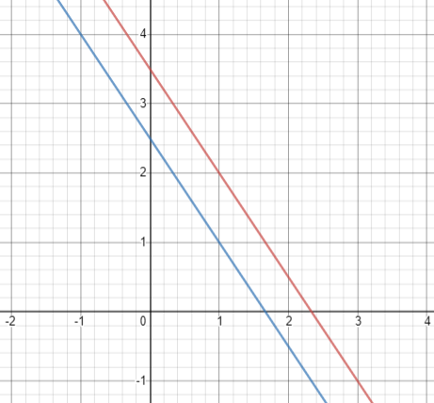
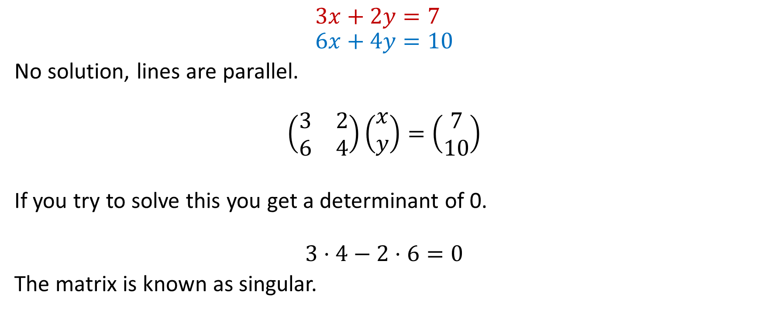
What about?
$$3x+2y=7 \\ 6x+4y=10$$
No solution, lines are parallel.
$$\left(\begin{matrix}3 & 2 \\ 6 & 4\end{matrix}\right)\left(\begin{matrix}x \\ y\end{matrix}\right)=\left(\begin{matrix}7 \\ 10\end{matrix}\right)$$
If you try to solve this you get a determinant of 0.
$$3⋅4−2⋅6=0$$
The matrix is known as singular.

Slide 23
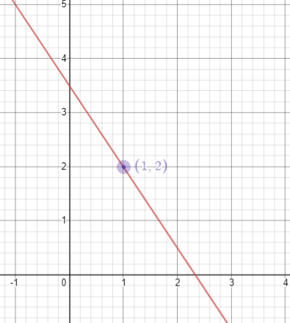
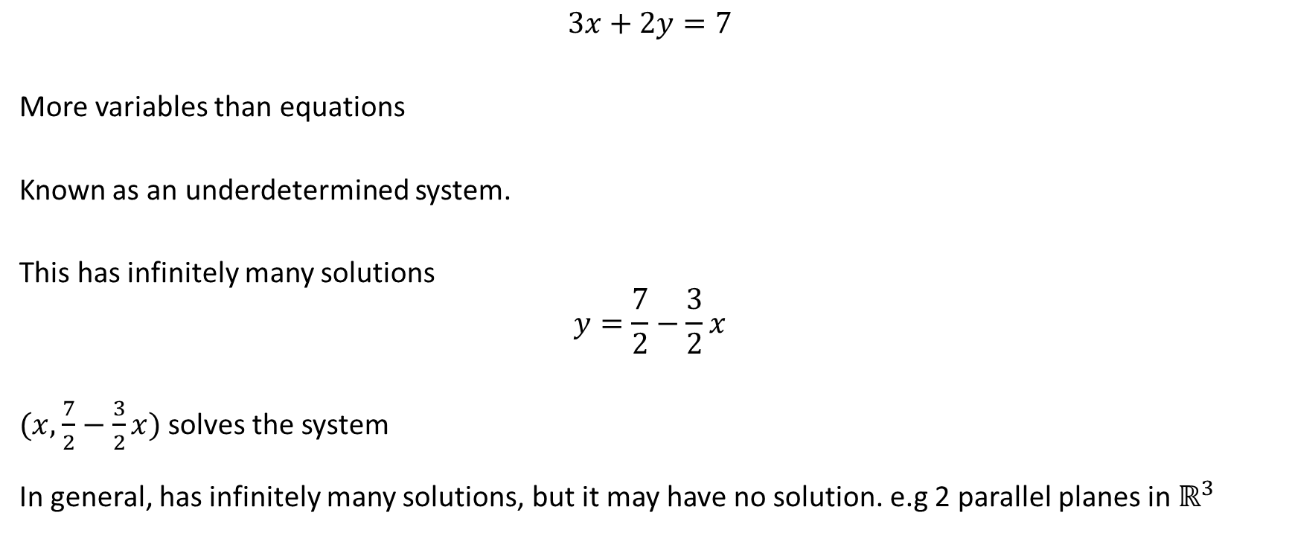
What about?
$$3x+2y=7$$
More variables than equations
Known as an underdetermined system.
This has infinitely many solutions
$$y=\frac{7}{2}−\frac{3}{2}x$$
$(x,$ $\frac{7}{2}−\frac{3}{2}x)$ solves the system
In general, has infinitely many solutions, but it may have no solution. e.g. two parallel planes in $ℝ^{3}$

Slide 24
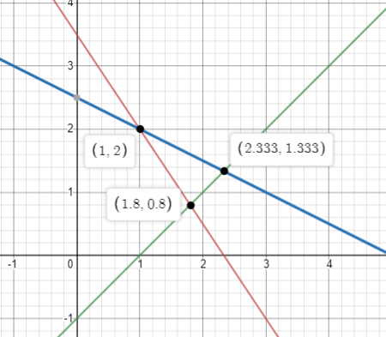
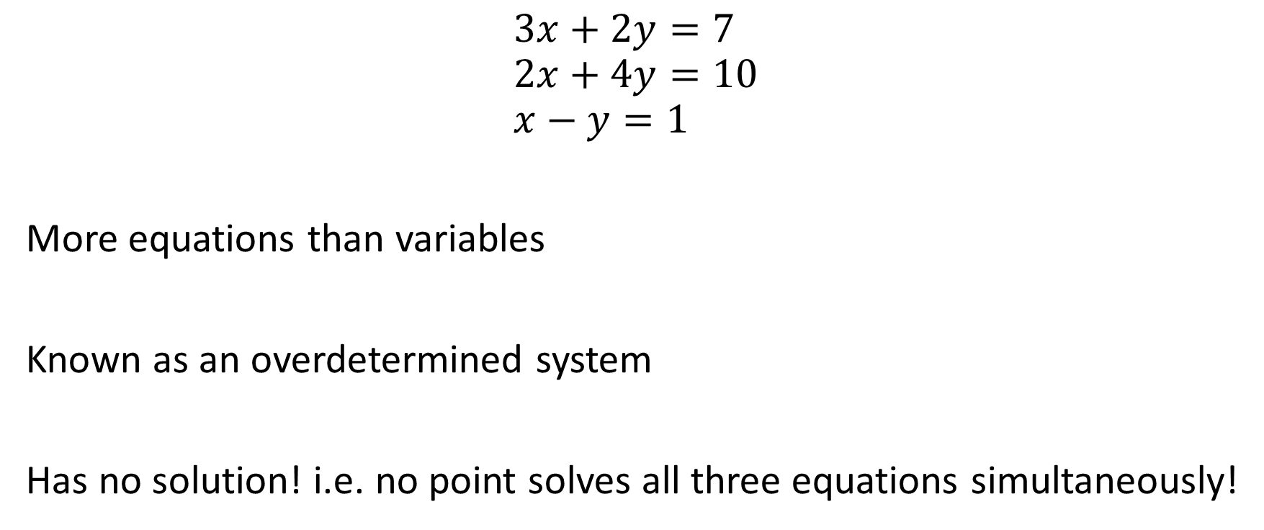
What about?
$$3x+2y=7 \\ 2x+4y=10 \\ x−y=1$$
More equations than variables
Known as an overdetermined system
Has no solution! i.e. no point solves all three equations simultaneously!

Slide 25
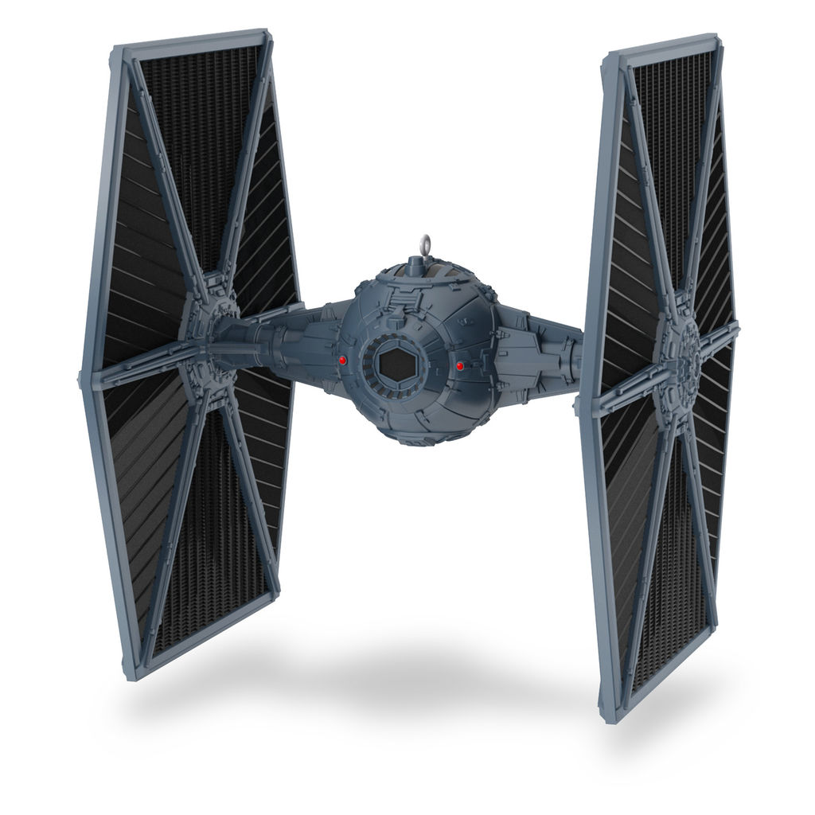
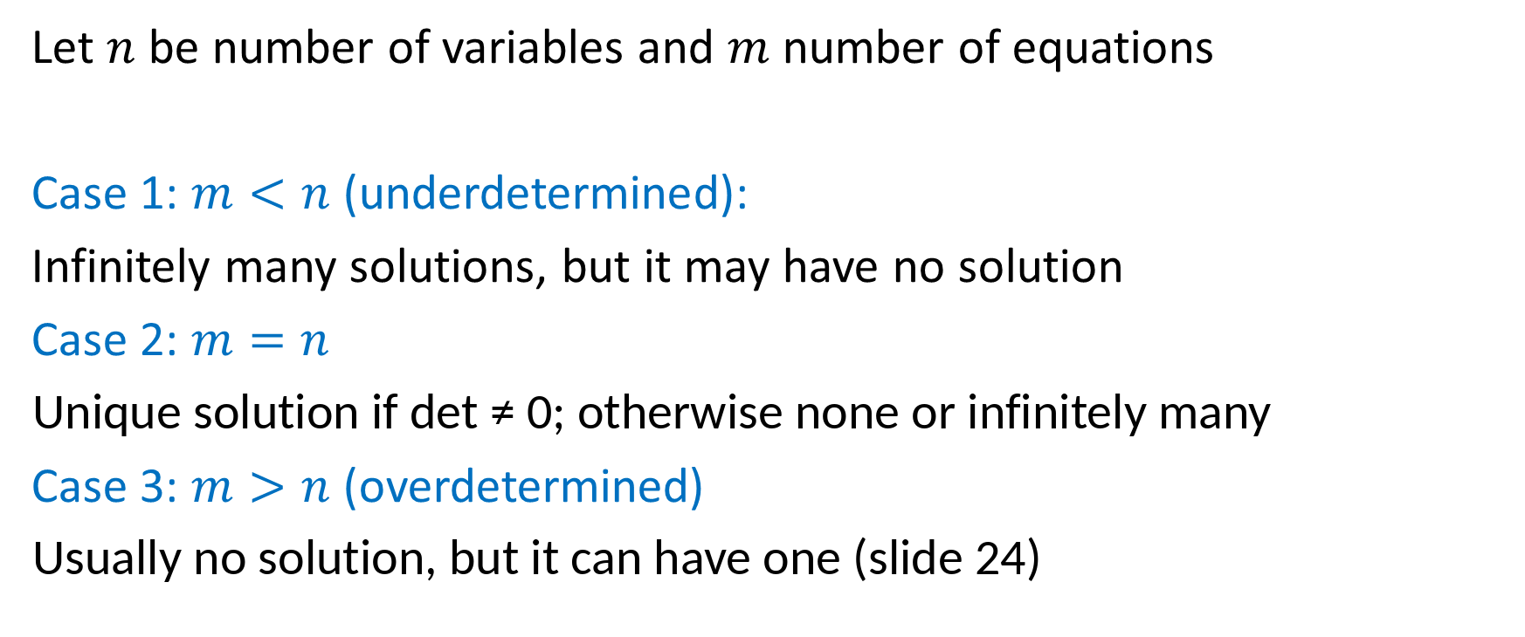
In general
Let $n$ be number of variables and $m$ number of equations
Case 1: $m<n$ (underdetermined):
Infinitely many solutions, but it may have no solution
Case 2: $m=n$
Unique solution if det ≠ 0; otherwise none or infinitely many
Case 3: $m>n$ (overdetermined)
Usually no solution, but it can have one (slide 24)

Slide 26
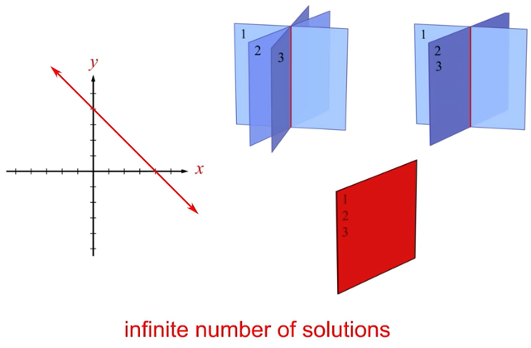
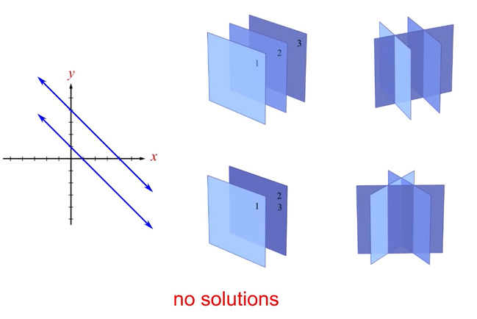
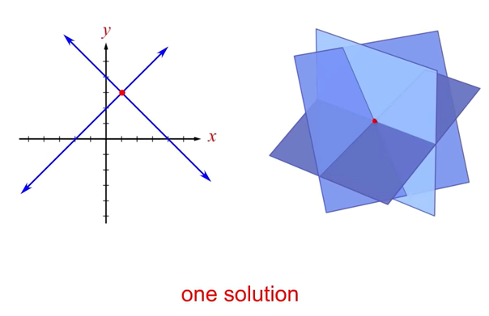
Visual solutions in 3 dimensions
https://www.youtube.com/watch?v=WAzUwzV1F3g

Slide 27
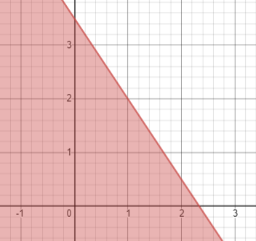
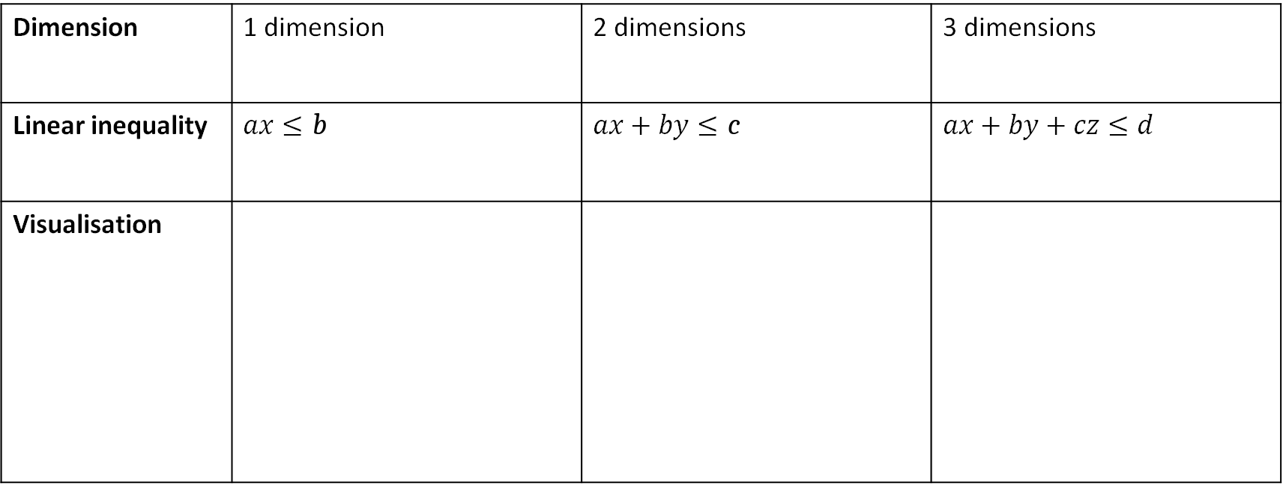
Linear Inequalities
Dimension | 1 dimension | 2 dimensions | 3 dimensions
Linear inequality | $$ax≤b$$ | $$ax+by≤c$$ | $$ax+by+cz≤d$$
Visualisation

Slide 28
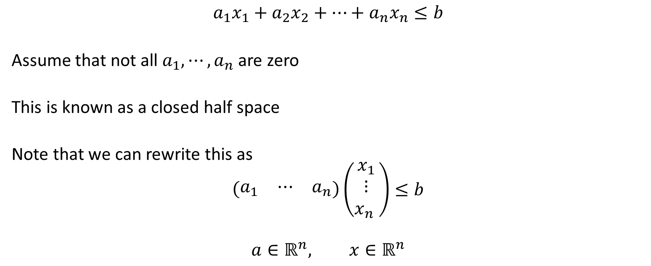
In general
$$a_{1}x_{1}+a_{2}x_{2}+⋯+a_{n}x_{n}≤b$$
Assume that not all $a_{1},⋯,a_{n}$ are zero
This is known as a closed half space
Note that we can rewrite this as
$$\left(\begin{matrix}a_{1} & ⋯ & a_{n}\end{matrix}\right)\left(\begin{matrix}x_{1} \\ ⋮ \\ x_{n} \end{matrix}\right)≤b$$
$$a∈ℝ^{n}, x∈ℝ^{n}$$

Slide 29
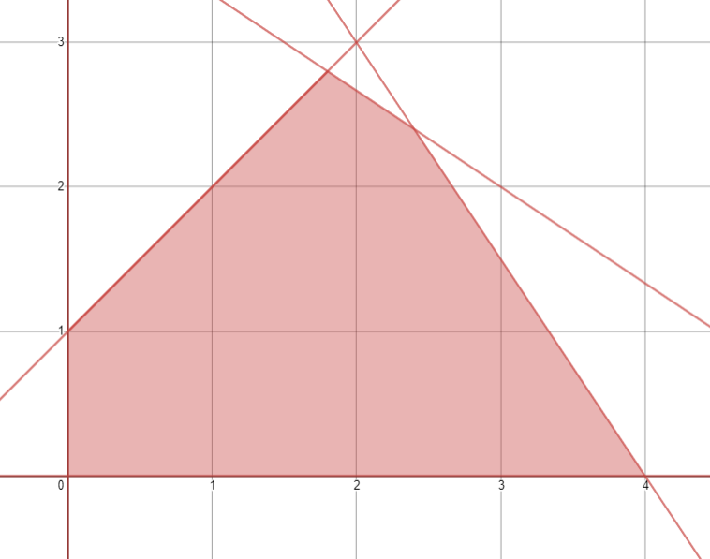

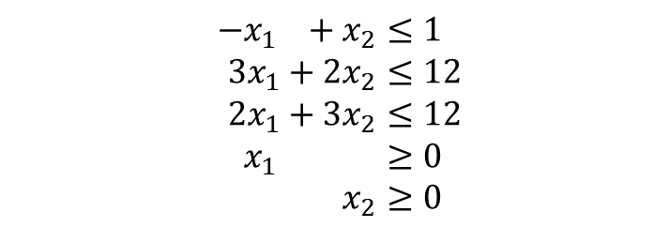


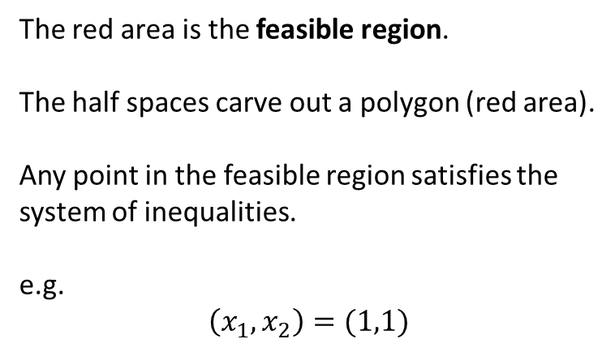




Systems of Linear Inequalities
$$x_{2}$$
$$−x_{1 }+x_{2}≤1 \\ 3x_{1}+2x_{2}≤12 \\ 2x_{1}+3x_{2}≤12 \\ x_{1 }+x_{2}≥0 \\ x_{2}≥0$$
$$−x_{1}+x_{2}≤1$$
$$2x_{1}+3x_{2}≤12$$
The red area is the feasible region.
The half spaces carve out a polygon (red area).
Any point in the feasible region satisfies the system of inequalities.
e.g.
$$\left(x_{1},x_{2}\right)=(1,1)$$
$$3x_{1}+2x_{2}≤12$$
$$x_{1}≥0$$
$$x_{2}≥0$$
$$x_{1 }$$

Slide 30
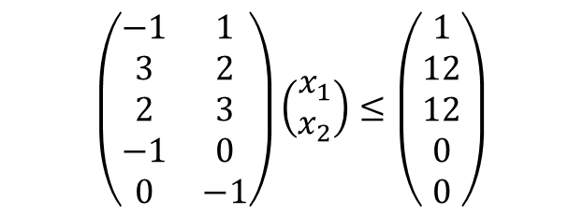

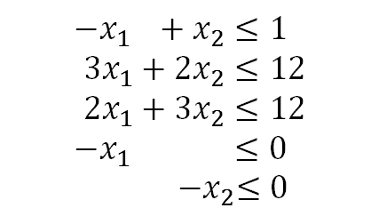
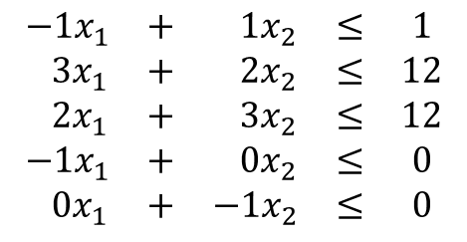
Systems of Linear Inequalities
$$−x_{1 }+x_{2}≤1 \\ 3x_{1}+2x_{2}≤12 \\ 2x_{1}+3x_{2}≤12 \\ x_{1 }+x_{2}≥0 \\ x_{2}≥0$$
$$−x_{1 }+x_{2}≤1 \\ 3x_{1}+2x_{2}≤12 \\ 2x_{1}+3x_{2}≤12 \\ −x_{1 }+x_{2}≤0 \\ { −x}_{2}≤0$$
$$\begin{matrix}−1x_{1} & + & 1x_{2} & ≤ & 1 \\ 3x_{1} & + & 2x_{2} & ≤ & 12 \\ 2x_{1} & + & 3x_{2} & ≤ & 12 \\ −1x_{1} & + & 0x_{2} & ≤ & 0 \\ 0x_{1} & + & −1x_{2} & ≤ & 0\end{matrix}$$
$$\left(\begin{matrix}−1 & 1 \\ 3 & 2 \\ 2 & 3 \\ −1 & 0 \\ 0 & −1\end{matrix}\right)\left(\begin{matrix}x_{1} \\ x_{2}\end{matrix}\right)≤\left(\begin{matrix}1 \\ 12 \\ 12 \\ 0 \\ 0\end{matrix}\right)$$
This is the matrix form of the system of inequalities, we will see this a lot!

Slide 31
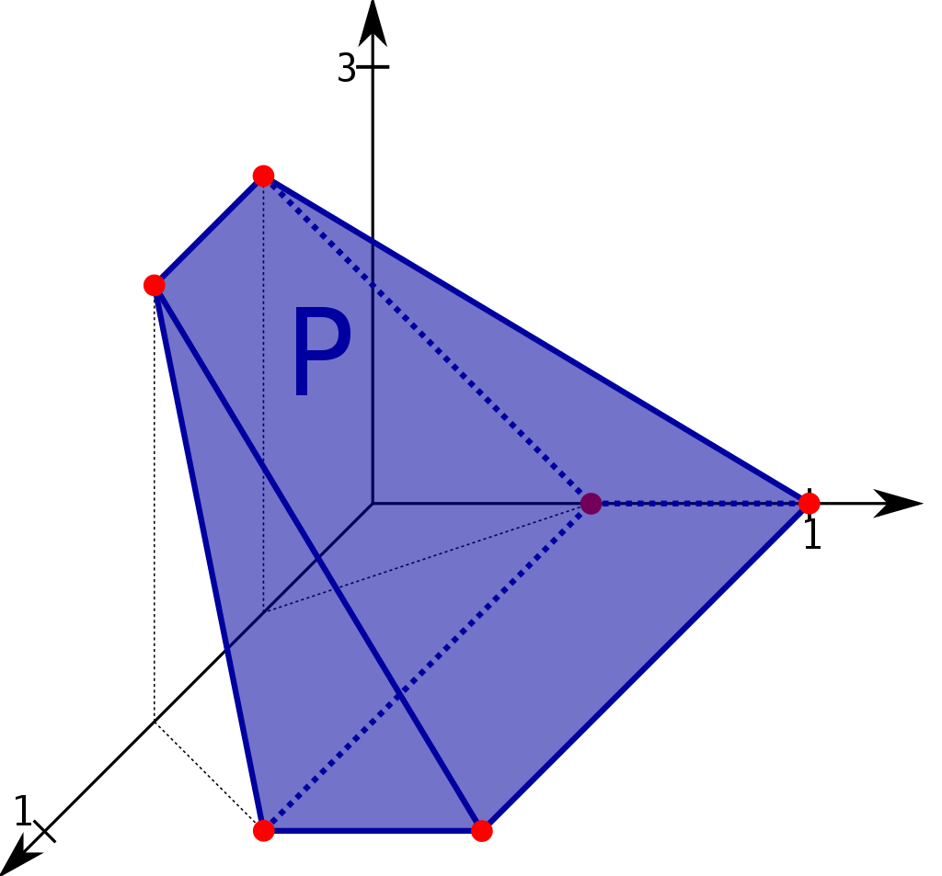
Visualisation in 3 dimensions
In 2 dimensions our half-spaces intersect to form a polygon
In 3 dimensions our half-spaces intersect to form a polyhedron
In n dimensions our half-spaces intersect to form a polytope.
Advanced: Both of these shapes are convex

